Slide 1
Requirement Management

Slide 2
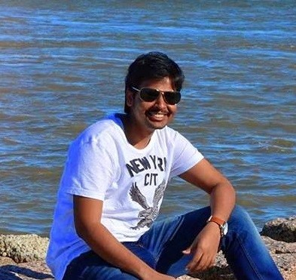


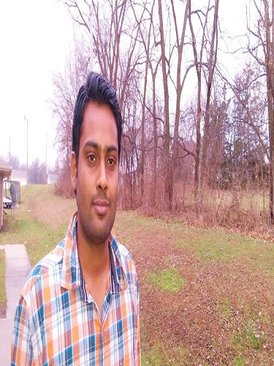
Team Members
Lokesh Reddy
Harsha Yadav
Manoj
1
Pradeep Nandyala

Slide 3
Contents
Basic terms and concepts of requirement management
How we incorporated requirement management in our
project
Way of collecting requirements and what makes good
use case?
reQtest demo and surveys
2

Slide 4
What is ?
Functional Requirement
Non-Functional Requirement
Usecase
Userstories
Static Requirements
Dynamic Requirements
Lokesh Reddy
3

Slide 5
Functional Requirements
It defines a function of a software system or its component
What is a Function?
Inputs,behavior,output
Lokesh Reddy
4

Slide 6
Non Functional Requirements
Non-functional requirement is a requirement that specifies criteria that can be used to judge the operation of a system
No inputs, outputs.
Various parameters.
Lokesh Reddy
5

Slide 7
Non Functional Requirements
Performance
Response
Scalability
Reliability
Usability
Maintainability
Lokesh Reddy
6

Slide 8
Usecase
Usecase is defining interaction between people and
technology as functional requirement for it applications
Ivar Jacobson ,1990
Interaction b/w entities
Plain text , diagram
Plain text – interaction textually
Diagram – useful lot of actors
No if’s
Lokesh Reddy
7

Slide 9
Usecase
Path : Actions and reactions we experience in executing the assignment.
Alternate Paths
Standard Path
Lokesh Reddy
8

Slide 10
Usecase Demo
Assume you missed a call from your friend and your phone is switched off now you need to check the mobile by turning it on!
Write Usecase for the above scenario
Pre condition : phone is switched off
Post condition : find the missed call and call him
Lokesh Reddy
9

Slide 11
Usecase Demo
Use case : Return Missed Call
Pre-Condition: Phone is switched off.
I press the power button and hold for 5 seconds
Phone displays the apple logo for 4 seconds
Then phone displays lock screen
Unlock the phone
Press the phone icon on the home screen
You will see keypad
In the same row you will find recents tab select that
On the top you can see missed option
Select that so you see missed call list and make a call to him
Post condition: find the missed call and place a call
Lokesh Reddy
10

Slide 12
Usecase Alternate Path demo
Use case : Return Missed Call
Pre-Condition: Phone is switched off.
S1 press the power button and hold for 5 seconds
S2 Phone displays the apple logo for 4 seconds
……...
S9 Select that so you see missed call list and make a call to him
Post condition: find the missed call and place a call
Alternate Path(If phone’s battery is low)
A01: @S1,The phone does not turn on.
A01.1 I locate an electric outlet.
A02.2 I plug phone into outlet.
A03.3 The Phone displays Charging symbol
A04.4 RESUME @S2
Lokesh Reddy
11

Slide 13
UserStory
It helps to create a simplified description of a requirement.
Customer and Provider
Requirements : Customer wants and developer can deliver.
Stakeholder requirements in projects
Lokesh Reddy
12

Slide 14
UserStory
Written requirements
can be well thought through, reviewed and edited
provide a permanent record
are more easily shared with groups of people
time consuming to produce
Verbal requirements
instantaneous feedback and clarification
easier to clarify and gain common understanding
more easily adapted to any new information known at the time
Lokesh Reddy
13

Slide 15
Structure of user stories
Structure of user stories
As a Role the Author represents I/We can do or have something
with these qualities to achieve my goal or objective.
Lokesh Reddy
14

Slide 16
User story example
As a website visitor, role
I can view all training do something
which I need to qualify quality requirement
For java exam goal or objective
Lokesh Reddy
15

Slide 17
Good Userstories should be
Independent :Independent.
Valuable : written in user language. They should be features, not tasks.
Lokesh Reddy
16

Slide 18
Good Userstories should be
Estimable: enough information to estimate, without being too
detailed.
Small : User Stories should be small. Not too small. But not too big.
Testable : Not too subjective and to provide clear details of how the User Story will be tested.
Lokesh Reddy
17

Slide 19
Static and Dynamic Requirement
Static Requirement
No particular way
User stories
Dynamic Requirement
Step by step tasks
Use case
Lokesh Reddy
18

Slide 20





Functional Requirements
19
Harsha Yadav

Slide 21


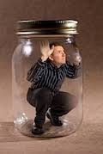

Non Functional Requirements
20
Harsha Yadav

Slide 22
Dynamic requirements through Use cases
21
Harsha Yadav

Slide 23
Static requirements through User stories
Login to the application using his/her credentials
Alert the guard regarding the situation by sending the
location message
Checking the history of the request raised by him/her
Sign up for the application
22
Harsha Yadav

Slide 24
what makes a good use case
Use cases used to identify the business goals to be
accomplished by a software system.
Use case, an important concept in use case analysis.
Represents a unique objective that the business
stakeholders want to achieve.
use case aims at describing a system from external usage
viewpoint, rather than from developer's perspective.
Manoj
23

Slide 25
To prevent bad use case
Don’t write functional requirements instead of usage scenario text.
Don’t describe attributes and methods rather than usage.
Don’t completely ignore the user interface.
Don’t write in a passive or not the user’s voice.
Don’t focus on things outside the use case.
Don’t ignore system behavior.
Manoj
24

Slide 26
Process for Requirements Collection
These methods usually differ from one project to another
and one client organization to another.
Client meetings are important for requirements collection.
requirements for a new system are gathered from the
potential end-users of the system.
Questioners can be used effectively for requirements
collection process.
Manoj
25

Slide 27
Tips for requirement collection
Never assume that we know complete customer's
requirements
Get the end-users involved
At the initial levels, define the scope
requirements should be realistic, specific and measurable
Focus on making the requirements document crystal clear.
Manoj
26

Slide 28
Managing Requirements
Requirements management expert defines the following major steps in requirements management
Establishing a requirements management plan
Requirements elicitation
Developing the Vision document
Creating use cases
Supplementary specification
Creating test cases from use cases
System design
Manoj
27

Slide 29
Interviews
Interviewing stakeholders and users first point of all when
gathering requirements for projects
Pros:
You can achieve a deeper level of engagement in one
on one.
Cons:
It’s more time consuming than arranging one session with a group of people.
You miss out on people bouncing ideas off one another in a group session.
Manoj
28

Slide 30
Brainstorming
Brainstorming is done in the beginning of a new project,
with multiple stakeholders involved to capture initial ideas.
Pros:
You get a large amount of information in a short space of time.
Brainstorming make stakeholder feel more engaged
Cons:
You need to have the right format and a good facilitator, or the ideas could dry up
Manoj
29

Slide 31
Questionnaires and surveys
Questionnaires and surveys are an effective way to collect, analyze and understand
Pros:
It’s quick and you can send it to a large database very
quickly.
Cons:
It can be time-consuming to design and write a good
survey
Manoj
30

Slide 32
Requirement Management Tools
ReQtest Tool Features
ReQtest makes managing requirements effortless.
ReQtest supports both agile and traditional methods.
Makes it easy to get a complete overview of all documents.
Pradeep Nandyala
31

Slide 33
ReQtest Demo
Pradeep Nandyala
32

Slide 34
Role of Survey in Managing Requirements
Advantages
Relatively easy to administer.
Cost effective, but cost depends on survey mode.
Collecting data from a large number of respondents.
Gives extensive flexibility in data analysis.
Disadvantages
Respondents may not feel encouraged to provide accurate,
honest, answers.
Pradeep Nandyala
33

Slide 35
Conclusion
Requirements management
How managed in our project
Pros and cons
Demos and surveys
Pradeep Nandyala
34

